Slide 1








DIGITAL. INNOVATION. SCALE

Slide 2

Agenda
Template Method design patterns
What is Template Design Pattern
When to use
Examples
Questions and answers

Slide 3
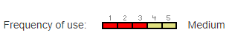
What is Template Method Design Pattern
Behavioral Design Pattern
Define the skeleton of an algorithm in an operation, deferring some steps to subclasses. Template Method lets subclasses redefine certain steps of an algorithm without changing the algorithm's structure.

Slide 4
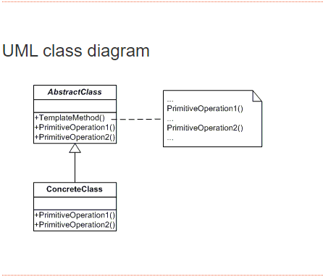
What we need for Template Method Design Pattern
Abstract Class
Concrete Class
Consumer

Slide 5
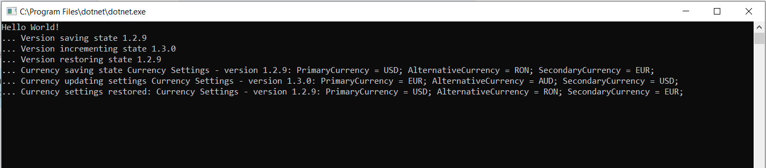
See Result

Slide 6
Advantages
Advantages
Cod Reuse.
Template methods are a fundamental technique for code reuse. They are particularly important in class libraries because they are the means for factoring out common behavior in library classes.
Inversion of Control.
Template methods lead to an inversion of control because subclasses no longer control how the behavior of a parent class is redefined.

Slide 7
Questions

Slide 8
References
GOF – Design Patterns - http://www.w3sdesign.com/GoF_Design_Patterns_Reference0100.pdf
Dotfactory - https://www.dofactory.com/net/design-patterns
Code example -https://gitlab.softvision.ro/enterprise.net/design-patterns/command

